Slide 1
Predicting the Road Accidents

Slide 2
Predicting road accidents helps traveller a lot
Severe traffic jam occurs due to road accidents on highway/normal road.
Waiting in severe traffic jam increase irritation, physical and mental tiredness. Time and fuel gets waste.
Predicting road accidents helps travellers to schedule their time of travel or travel path.
Traveller can save lots of time & fuel.
Patients can save their life by avoiding severe traffic jam by changing travel path or travel time.

Slide 3
Data acquisition and cleaning
Govt of Seattle has created the dataset and it is available here. It contains all types of collisions. Timeframe from 2004 to Present.
It has total 38 attributes. Its Metadata details are here.
Total 37 attributes/features (independent variable) are available. “Severity code” is the target label (dependent variable).
Dataset is mix of numeric and categorial features.
There are very less co-relation with numeric features and severity code. So, removed all those features.
Removed Samples, having “Nan”, “Unknown”, “Others” from categorial samples.

Slide 4
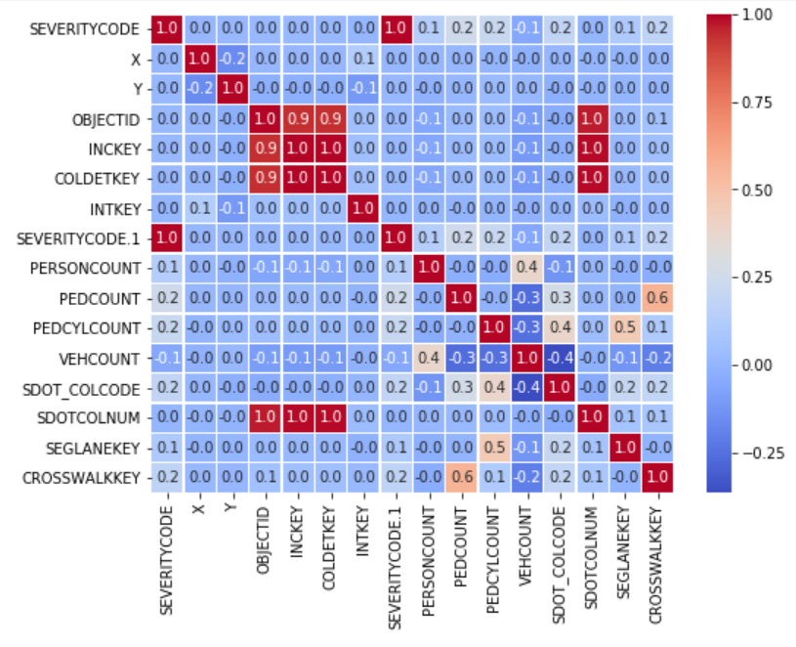
Correlation between numerical features
SEVERITYCODE and SEVERITYCODE.1 both are same.
No relationship between SEVERITYCODE and X, Y, OBJECTID, INCKEY, COLDETKEY, INTKEY, SDOTCOLNUM.
Very less relationship between SEVERITYCODE and PERSONCOUNT, SEGLANEKEY.
Strong correlation between ObjectID, INCKEY and COLDETKEY. But it doesn't have any correlation with severity code.

Slide 5
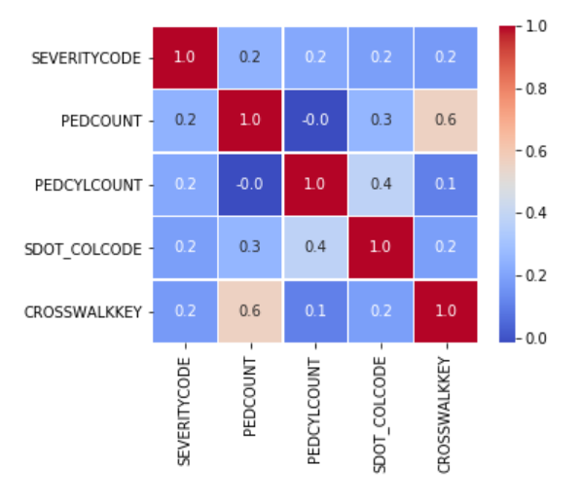
Correlation between numerical features
Target label SEVERITYCODE has very less correlation with below features:
PEDCOUNT - pedestrians involved in the collision
PEDCYLCOUNT - bicycles involved in the collision
SDOT_COLCODE - code given to the collision by SDOT
CROSSWALKKEY - crosswalk at which the collision occurred
All these features, doesn’t have relation with weather and road condition, so no need to consider.

Slide 6
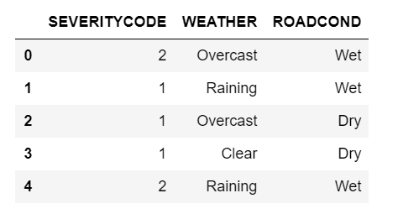
Feature selection
There are two direct features correlated with severity code are weather and road condition.
Both are categorial features.
Both features having number of unwanted samples. E.g: “Clear”, “Unknown”, “Other”.
Removed all these samples to clean the selected features to get good accuracy of model.
Severity code has only two values 1 and 2.

Slide 7
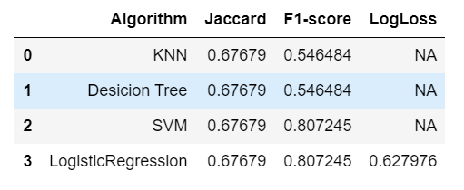
Performance of Classification models
As target label data are not continuous values, Chosen classification algorithm to trained the model.
F1 score of SVM and Logistic regression is more than KNN and Decision Tree algorithm.
Jaccard score is same for all the algorithms.
LogLoss value is 0.63 in Logistic Regression model.

Slide 8
Conclusion and future directions
SVM and logistic regression algorithms gives better accuracy compared to KNN and Decision tree algorithms.
To create the custom model, add the location information from two places and predict the possibility of accident on road to avoid traffic jam of particular area.
Using this model, Based on bad weather and bad road conditions, people can predict the severity of accident and traffic jam on road and they can save lots of time, fuel by changing their route and changing travel time.

